Slide 1

Bleisure Travel
More Pleasure than Business?
Ross Atkinson
RA Strategies

Slide 2


Slide 3






“Consumerization” Enablers
Mobile is off the charts – booking, check-in, tracking luggage, WiFi in the sky
Experiential focus, product & loyalty re-evaluations
Sharing “everything” => “subscription” economy

Slide 4

Mental Calisthenics
What is Bleisure?
Remember your best Bleisure trip?
Safe Bet, Roulette or Play the Over Under
Location, location, location
Distance makes the heart grow fonder

Slide 5
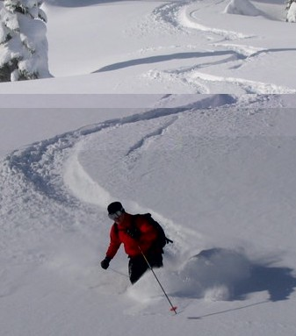
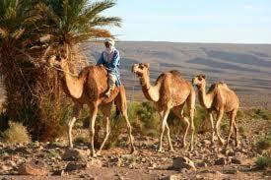
It’s bigger than we think
~43% of trips are estimated to add days for cultural activities, food, music, art or outdoor exploration
Conferences / convention travel are more likely to turn add Bleisure
International Travel: 58% of the time the # of Bleisure days exceed those planned for business

Slide 6



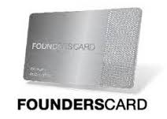
Finally Mixing Business and Pleasure
Bleisure travelers: A new tribe injects fun into business trips
Why Should Organizations Embrace “Bleisure” Travelling
Bleisure travel: The benefits of mixing business travel with leisure
Where top entrepreneurs and innovators plan to “Bizcation” in 2017

Slide 7
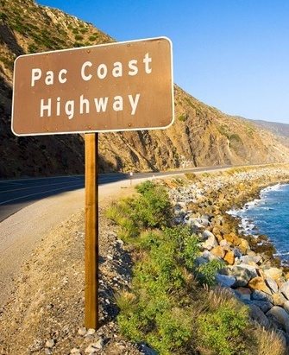
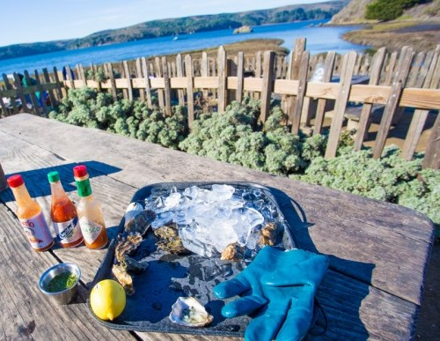
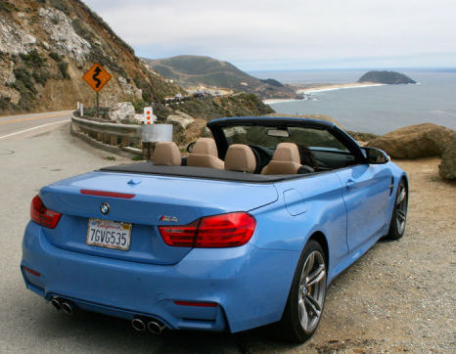
Nothing But The Wind in Your Hair

Slide 8
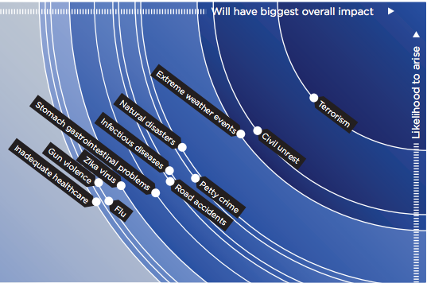
Bigger than GI or Door Dings

Slide 9
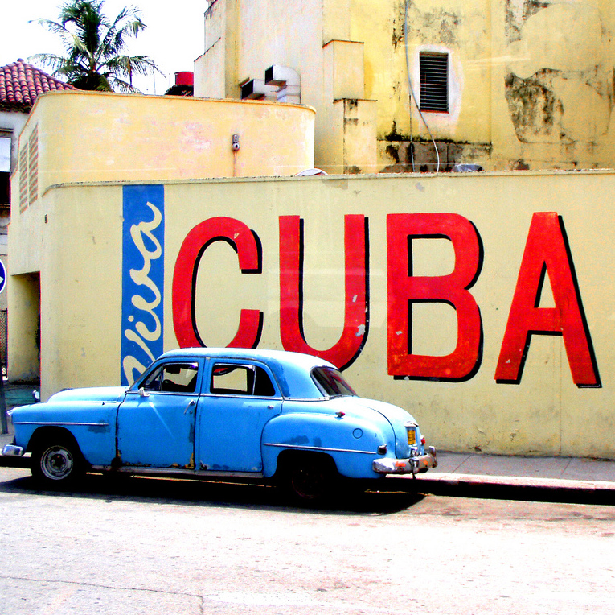
Context & Complications
  Liabilities
  Compliance
  Safety & Security
  Risk Mitigation & Response

Slide 10
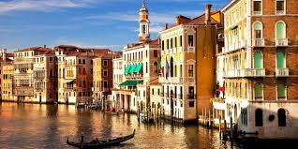
Approve a Bleisure trip?
London, UK
Venice, Italy
Barranquilla, Colombia
Quebec, Canada

Slide 11
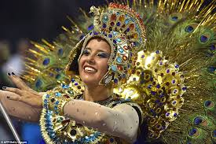
Welcome to the largest parties on the face of earth!
London, UK
Venice, Italy
New Orleans
Barranquilla, Colombia
Quebec, Canada
Rio de Janeiro

Slide 12
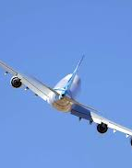
Liabilities of Bleisure
Gray lines
Case-by-case scenarios
Exceptions at the approving manager level
Conflicted by culture of employee care and health
Articulated in spirit but not in detail

Slide 13
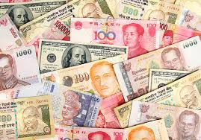
Compliance
If it costs less it is must be best for everyone

Slide 14
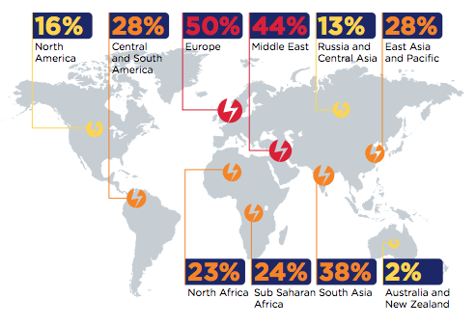
Compliance Flavors
Location
Distance, Class, VIP’s
If & when it happens, where is it booked
Considerations

Slide 15
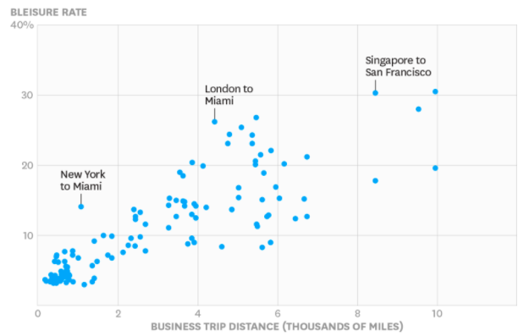
The Further You’ll Go, The More the Bleisure

Slide 16
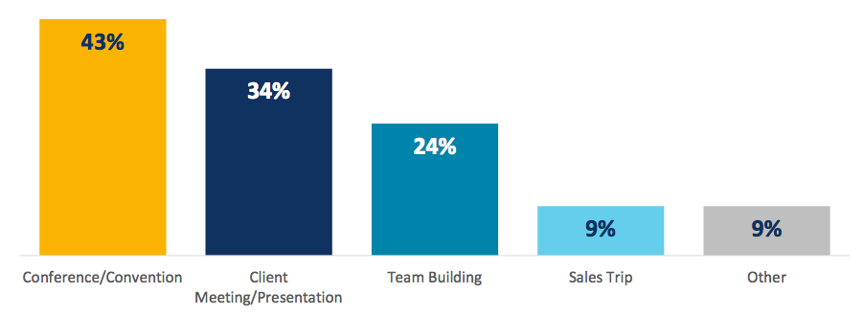
Compliance Considerations
Class
VIP’s, Road Warriors, Execs
Booking Channel
Retention and recruiting
Meetings
“Wokcation”
Retention and recruiting
Meetings
“Workcation”

Slide 17
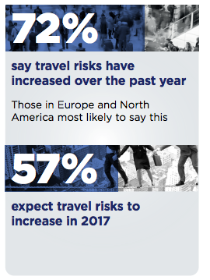
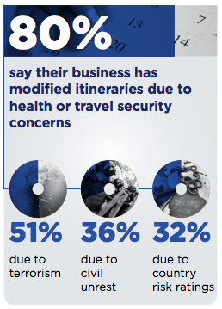
Safety & Security on the Rise
Offer access to Risk Tools for Bleisure?

Slide 18
Entrepreneurs are no Exception
81% of respondents plan to take trips that combine business and leisure.
51% plan to do this in 2017 on more than one occasion.
The New Bleisure
    23% of respondents say that they will be traveling in 2017 with the specific aim of co-working or a “workcation”

Slide 19

Our Different Customers

Slide 20
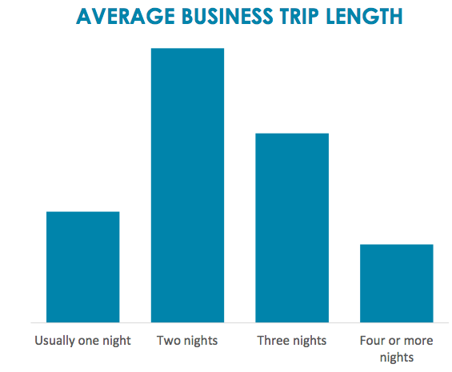
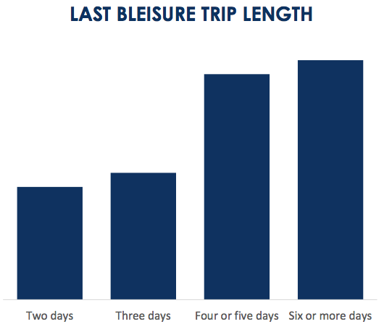
More Pleasure than Business

Slide 21

Can Business & Leisure Coexist

Slide 22
Resources
CWT Solutions Group - “A Quantitative look at the Bleisure Phenomenon”
    http://www.carlsonwagonlit.com/content/dam/cwt/pdf/insights/20160712-solutions-group-white-paper-bleisure.pdf
Expedia Media Solutions - “Discover the Untapped Mind of a Bleisure Traveler”
    https://info.advertising.expedia.com/custom-research-bleisure-travel-market
International SOS - Travel Risks & Realities
    https://www.internationalsos.com/risk-outlook
Harvard Business Review - How Many People Really Combine Work Trips with Vacation?
    https://hbr.org/2016/09/how-many-people-really-combine-work-trips-with-vacation

Slide 23
Resources (Cont.)
CNN - Bleisure travelers: A new tribe injects fun into business trips
    http://www.cnn.com/2015/10/13/travel/bleisure-travel/
CEOworld Magazine - Why Should Organizations Embrace “Bleisure” Travelling
    http://ceoworld.biz/2017/02/06/organizations-embrace-bleisure-travelling/?utm_source=ceoworld&utm_medium=CEOWORLD+magazine&utm_campaign=twitter
Sabre - Bleisure travel: The benefits of mixing business travel with leisure
    https://www.sabre.com/insights/bleisure-travel-the-benefits-of-mixing-business-travel-with-leisure/
Founderscard - Where top entrepreneurs and innovators plan to vacation in 2017
    http://blog.founderscard.com/2016/12/14/the-places-youll-go-where-top-entrepreneurs-and-innovators-plan-to-vacation-in-2017/

Slide 24


Slide 25
Thank You
Ross Atkinson
RA Strategies
703-395-7145

