Slide 1

Mastering Managed Travel
A Guided Tour of GBTA’s
Managed Travel Index®
Kathy Bedell
Senior Vice President, BCD Travel
April 9, 2019

Slide 2
Agenda
Managed Travel Index® (MTI®) Overview
MTI® Guided Tour and Deep Dive
Q&A
Notes:
Talk about background of tool
Managed Travel Index®: it was more than six years old. With all these market dynamics and the changing marketplace the MTI needed an update. The purpose of the updated assessment remains the same as with the previous tool: to benchmark the operational effectiveness and efficiencies of a managed travel program. Most importantly, the Task Force took this former U.S.-only tool to a comprehensive, global level to increase its usefulness and value.
To achieve the goals two Task Forces were created. The task forces worked more or less over a period of 12 months on developing the content (questionnaire, recommendations, scoring).

Slide 3

MTI® tool
What’s the point?
Assists non-supplier travel professionals
Module based set-up
Identifies areas of strength and opportunity
Provides real-world, strategic recommendations for improvement
Determines overall status of your travel program
Collects data for peer benchmarking
Notes:
The Managed Travel Index® is a tool designed to help identify areas of strength and opportunity within your travel program.
Designed exclusively for non-supplier travel professionals (especially newbies in this role/in this industry), each section is self-contained and comprised of a battery of questions that will determine the managed or non-managed status of your travel program respectively the maturity level of your travel program as it relates to sustainability. Users will receive recommendations to help strengthen the overall program. The overall goal is to receive the recommendations, take action, and then come back to the tool with updated answers to test overall progress.
Question for the audience: Who is new in to the industry or new in the role of a travel manager/sourcing manager?

Slide 4
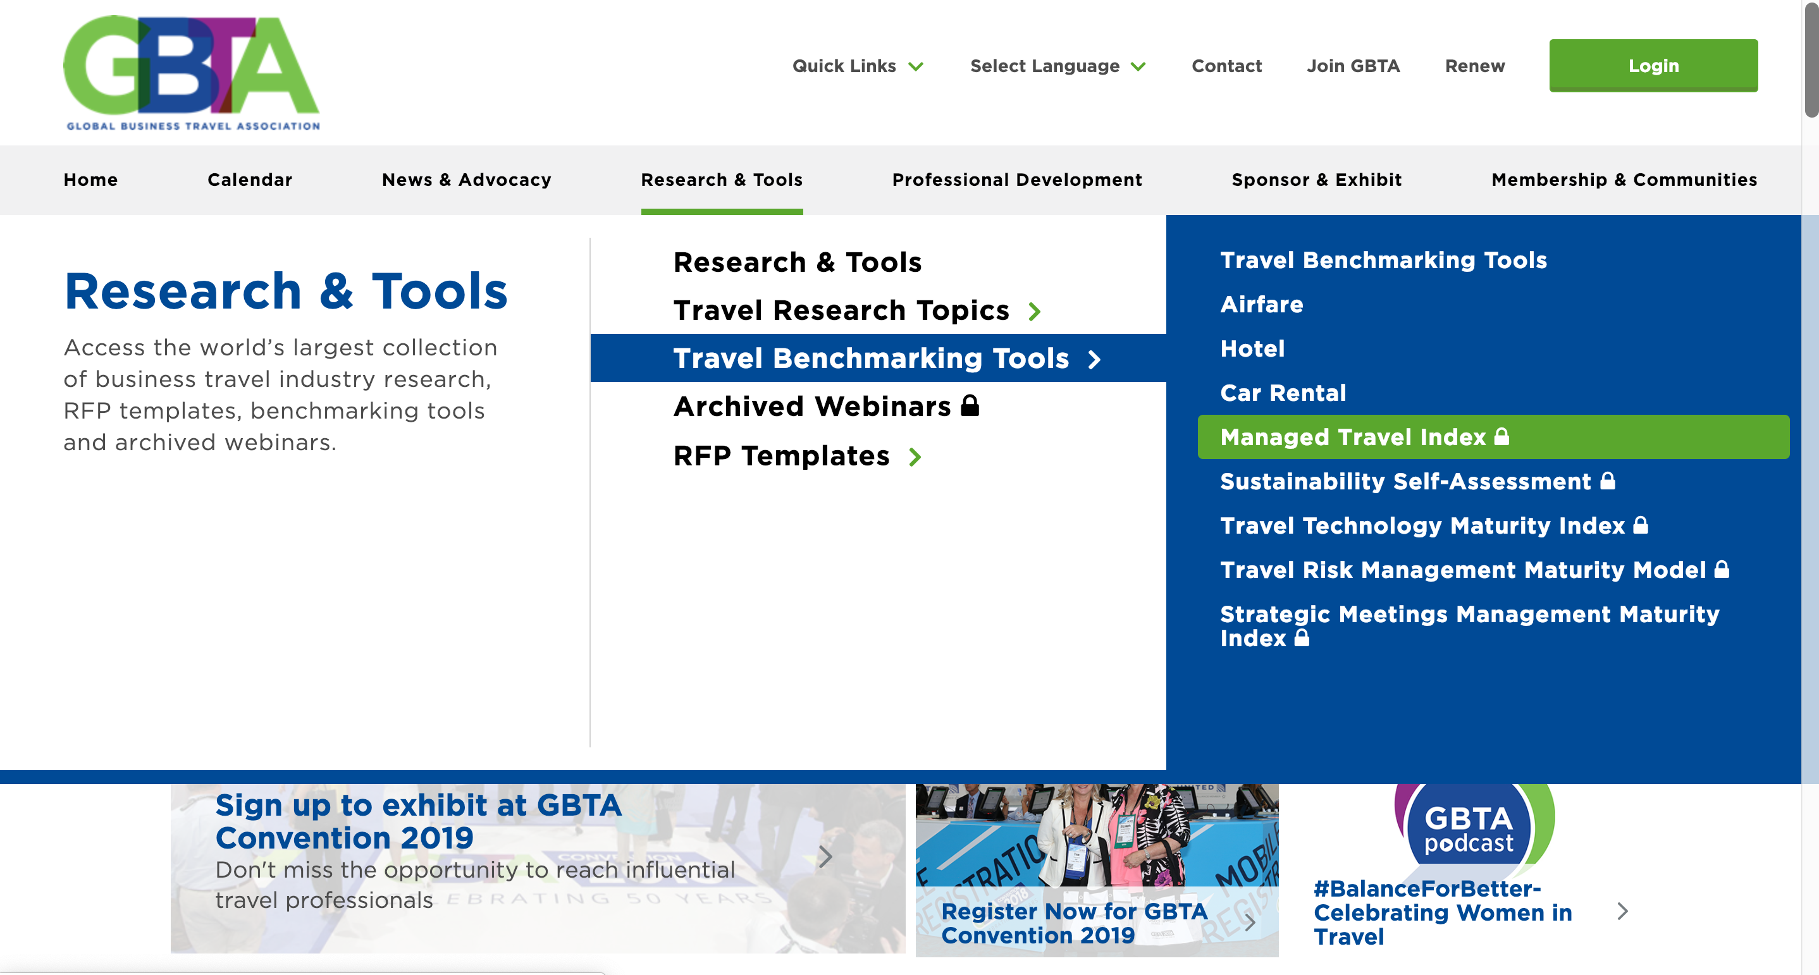

Where can you find the tool?
Navigate to the Benchmarking Tool section of the GBTA website
GBTA.org
Research & Tools
Travel Benchmarking Tools
Managed Travel Index
Notes:
Navigate to the Benchmarking Tool section of the website
GBTA.org -> Research & Tools -> Travel Benchmarking Tools -> Managed travel Index
User friendly
Self-explanatory
Easy-to-use

Slide 5
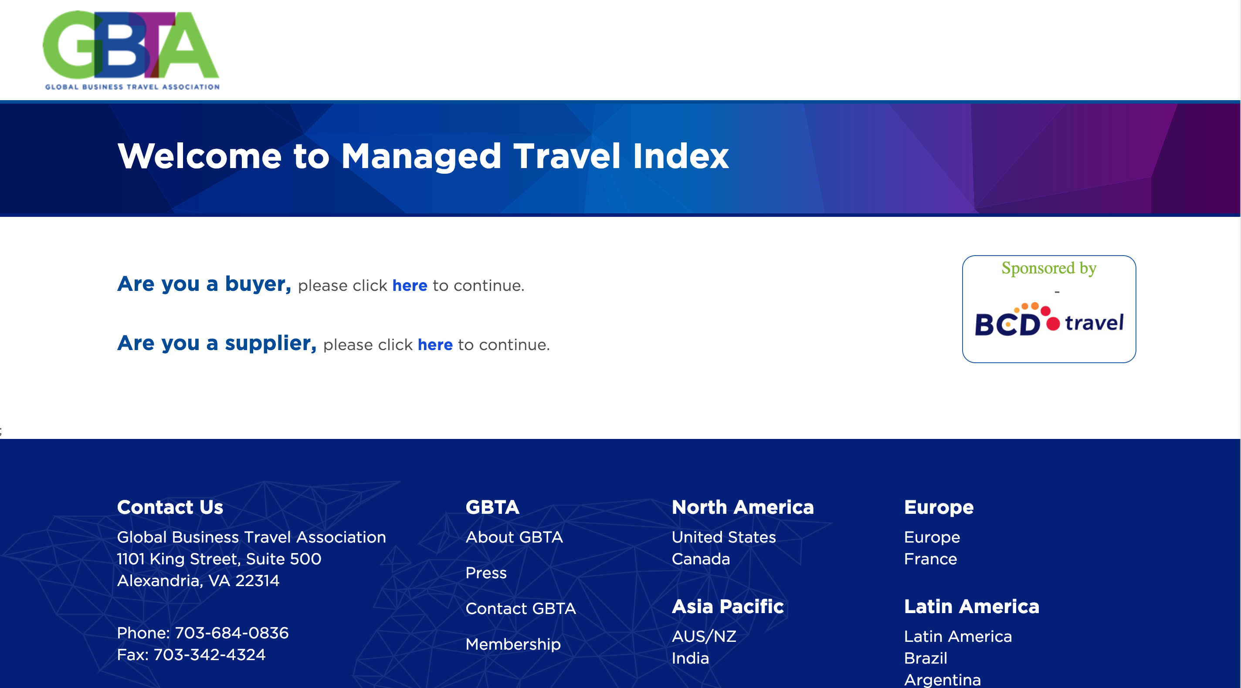
Getting Started
Notes:
It prompts you to log in (so it‘s for GBTA members only)
If there are people who do not remember their password they can reach out to GBTA (Paul Yachnes – pyachnes@gbtafoundation.org)

Slide 6
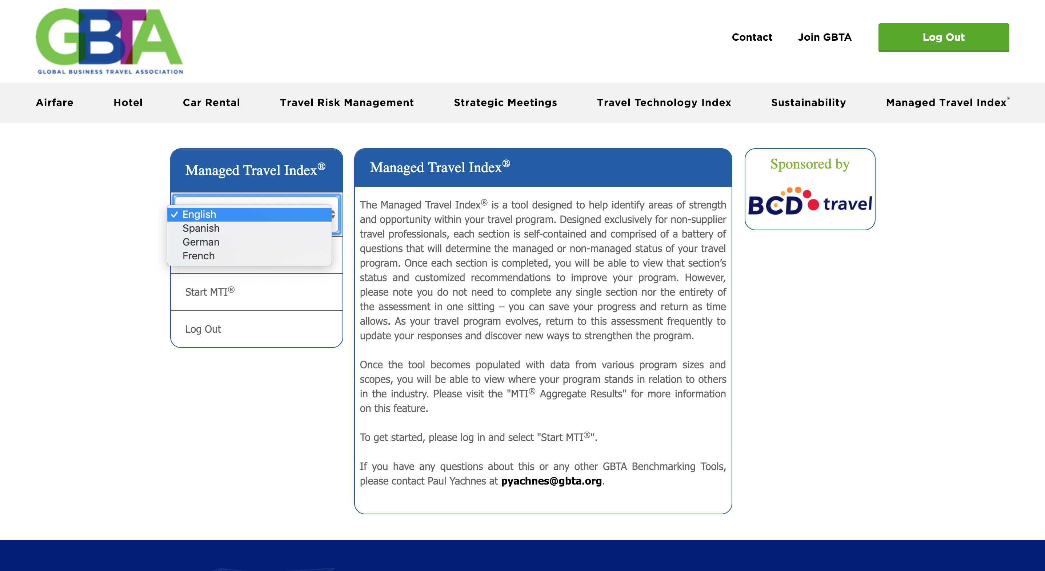
Getting Started
Notes:
After the log-in, select your language.
You can switch back and forth at any time. Example: Start with Spanish because you are fluent. Then you need a phrase translated, switch to English no problem – your language settings can be changed.
Click on “Start MTI®“

Slide 7
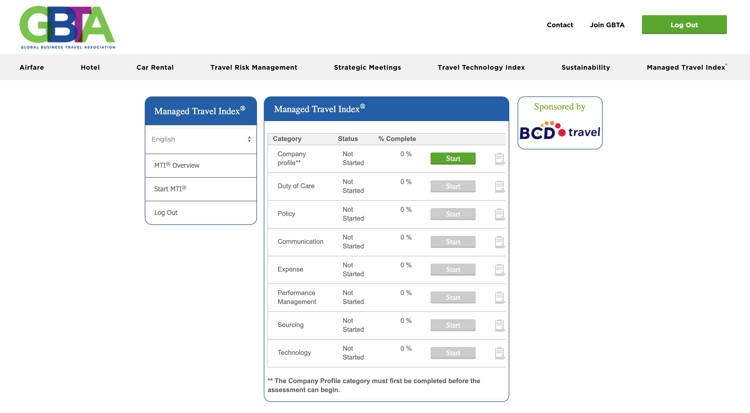
The Company Profile
Notes:
First section to complete: “company profile“
Necessary because the entered data feed into other questions and will also feed into the benchmarking piece that is still locked at the moment.

Slide 8







Managed Travel Index®
What’s measured?
Policy
Expense Management
Sourcing
Duty of Care
Communication
Performance Management
Technology
Notes:
Areas assessed by the MTI.
Focus on key functions of a travel program

Slide 9
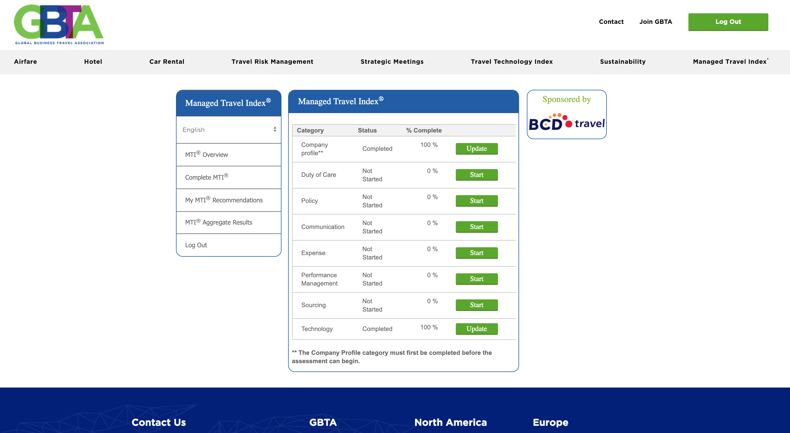

Complete Desired Assessment areas
Notes:
Once you completed the company profile, start with any other section. No need to do all to recieve your recommendations. If you just want to do one piece (e.g. technology piece) then just complete that section and you‘ll get your information once your done with that section.
You can also stop at any point in a section, save it and come back at any time.

Slide 10
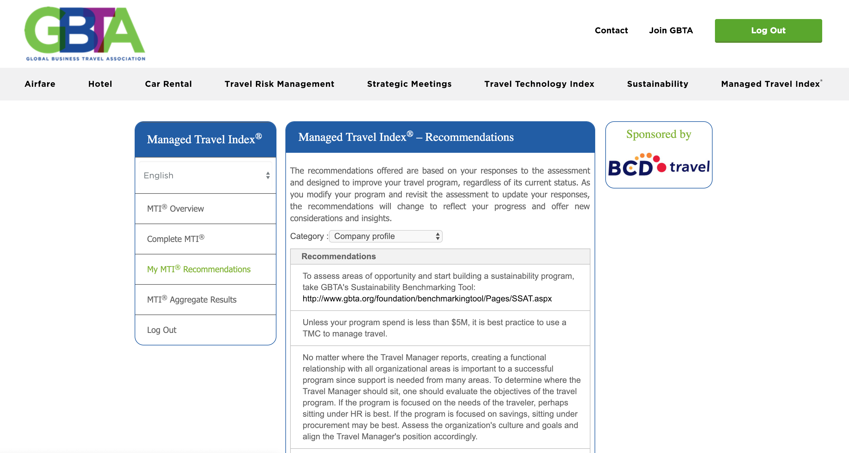
Access Your Recommendations
Notes:
Access recommendations: left hand side
It always starts with the company profile – that‘s pre-set

Slide 11
Repeat as Desired
Make programmatic changes
Update the assessment
Read
recommendations
Notes:
Take the sections that apply to you, read and apply the recommendations, come back and update the assessment after some time, read and apply recommendations… - an evergreen tool. Even if you reach a managed level in all section you get recommendations.

Slide 12
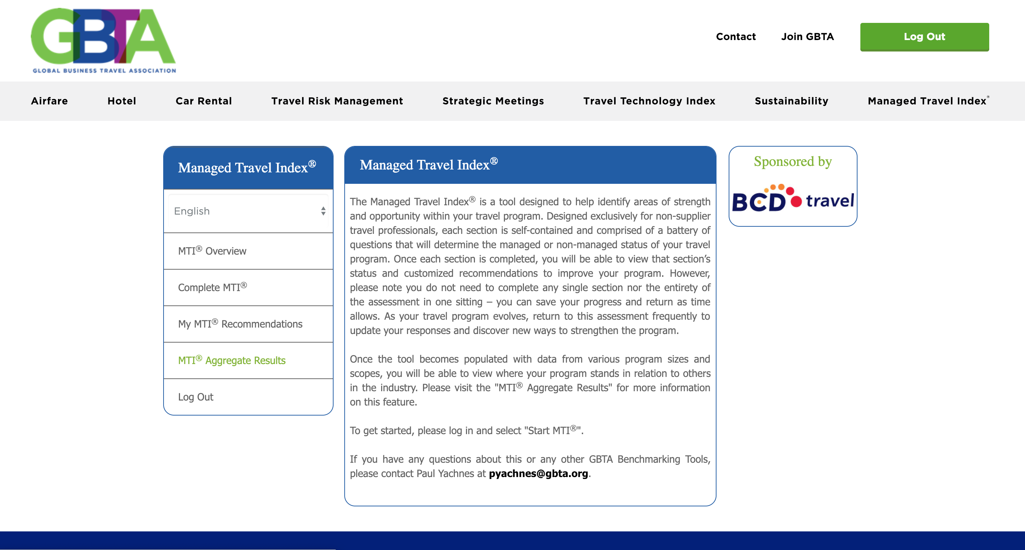
Compare with Your Peers

Slide 13
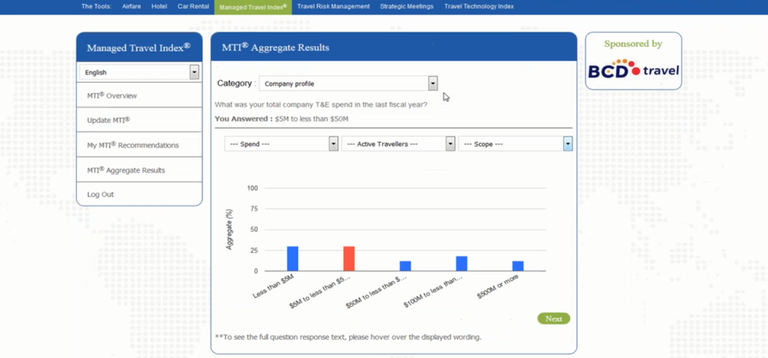
Compare with Your Peers
Notes:
Example: you see the category, the question and your answer (in red).

Slide 14
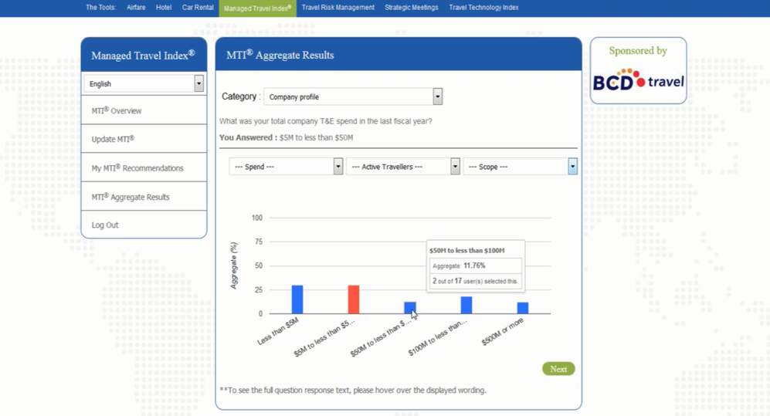
Compare with Your Peers
Notes:
When you hover over a bar, more information will pop up. You see where you fall in comparison to everybody else.

Slide 15
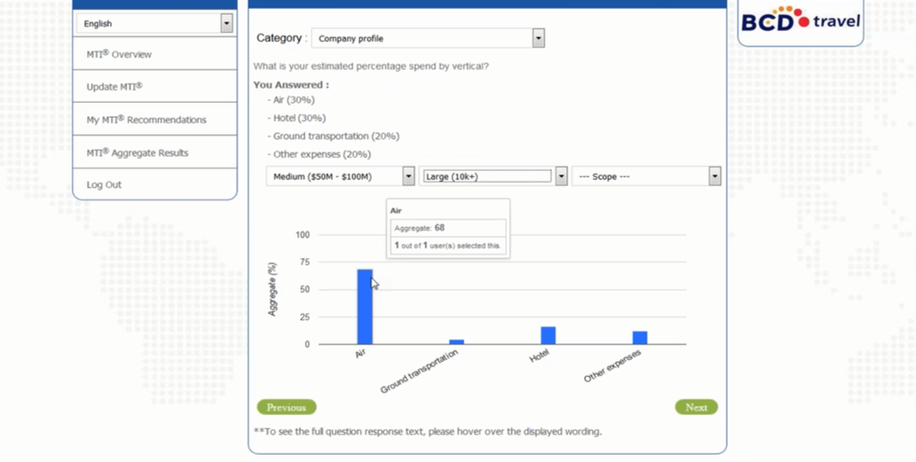
Compare with Your Peers
Notes:
Taking it a step further, you can work with the filter dropdown. Select your company size, number of travelers and scope (global, multinational or national).

Slide 16
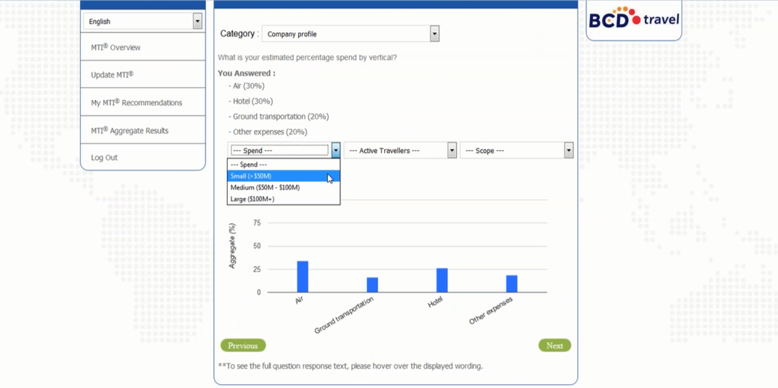
Compare with Your Peers
Notes:
With a change in the filters, the bars change dynamically as well.

Slide 17


Benefits of Benchmarking
Uncover what similar travel programs are doing
Learn about
best practices
Receive customized recommendations for improvement
Identify success stories and discover gaps for improvement to share with your team
Record 2 Global Travel Professional (GTP)
Certification credits
01
02
03
04
05

Slide 18
Managed Travel Index® Benchmarking Areas
Duty of Care
Travel Policy
Communications
Expense
Performance Management
Sourcing
Technology

Slide 19
Results
Notes:
Now lets take a peak at some of the data points coming from those who have already taken the MTI. This is just to give you a little taste of the kinds of information you will take away from the benchmarking functionality when you use the tool.

Slide 20

Most Travel Programs Have a Travel Duty of Care Policy…
Do you have a travel duty of care policy? (n=144)
40%
24%
36%
Yes
Our Duty of Care Policy
exists but is not under
the travel policy
No
Notes:
Data from the Managed Travel Index. Snapshot taken in December 2018.

Slide 21
Travel Manager Influence Over The Policy
How much influence does the travel manager/team have over the travel duty of care policy? (n=141)
Notes:
Data collected from the MTI indicates that most travel managers do exert influence over policy.

Slide 22
Traveler profiles remain a challenge
Do you have a process in place to ensure traveler profiles are up to date in case of an emergency? (n=144)
63%
37%
Yes
No

Slide 23
Do Policies Have “Mandated” Rules or Guidelines?
Which of the following best describes your company’s travel policies? Travel policies include rules like whether or not you are allowed to fly first class, the type of hotel room (n=133)
41%
59%
Mandated
Travel Policies
General
Guidelines
Notes:
Companies applying general guidelines outnumber those mandating travel policies.

Slide 24
Data Consolidation is on the Rise
But many programs have room to improve
Which of the following sources do you use to gather the data for consolidation? (n=88)
Do you consolidate travel data centrally? (n=110)
if yes
Notes:
Travel programmes are becoming more data-driven. Part of the reason is that they have better tools that they can use to analyze their data. You hear a lot about benchmarking, for instance.
AI and machine learning will make data even more important. To take full advantage, it’s important to consolidate data from multiple sources. When you look back even a few years, I think companies are doing a much better job consolidating data today. However, some still have work to do. One-fifth of our respondents don’t consolidate data centrally. Even when they do consolidate data, 28% don’t include expense data, 40% don’t include supplier data, and 42% don’t include payments/card data.

Slide 25
Two-thirds of Respondents Share Travel Data With Senior Management
Do you provide reports (e.g. summary of travel, program performance) to senior management within your company? (n=109)
Do you provide TMC reports to business units within your company? (n=109)
Notes:
Harmony – How do you use your TMC reports?

Slide 26
Respondents Have Limited Influence Over Expense Management
How much influence do you have over the expense management program? (n=120)
53%
Notes:
Harmony – how closely do you work with your expense/finance team? How much influence do you have over things like your payment products/expense management tool?

Slide 27
Questions?
Notes:
I’m admittedly not the leading authority on the Managed Travel Index, but if I’m unable to answer your question today, I can follow up with you later. And I’m happy to discuss parts of your travel program that you may be facing challenges with.

Slide 28

Thank you

