Slide 1
Hotel Sourcing 2015
May 12, 2015
Connecticut/Westchester Business Travel Association
Presenter : Traci Egermayer

Slide 2
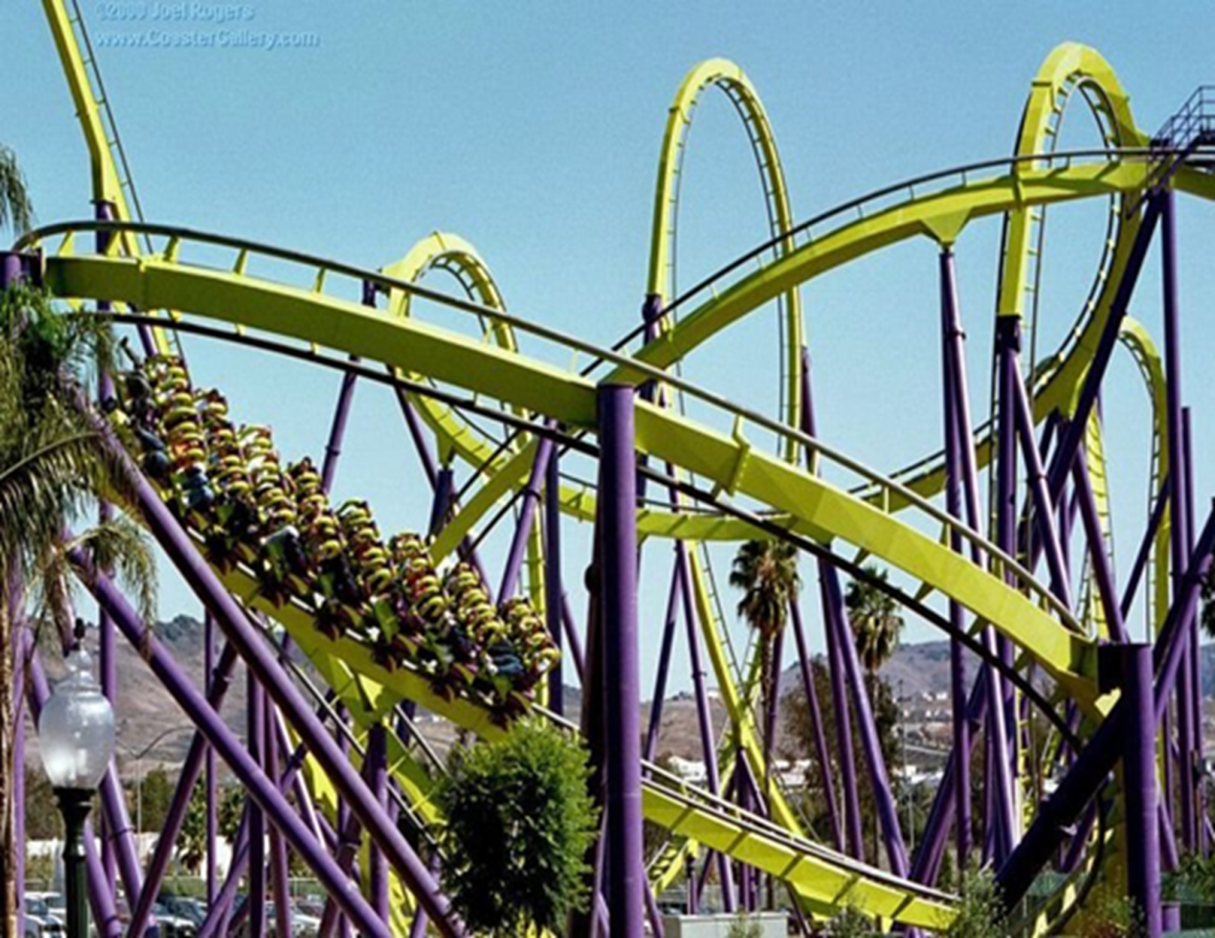
State of the Industry

Slide 3

2015 Season Recap
North America
6.0%
*USA 11.6%
Europe
1.3%
Asia
.4%
Middle East
2.3%
Africa
2.1%
Latin America
30.8%
*Chile/Colmbia
SW Pacific
2.2%

Slide 4
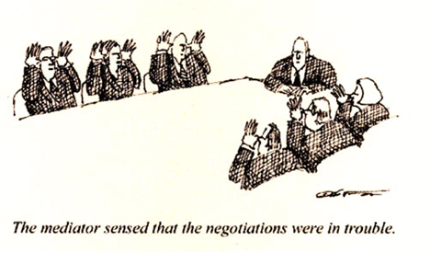
There's a large difference between what buyers are expecting and what sellers are expecting!

Slide 5

Keep Negotiations Personal
In order for negotiations to be successful, you need to have two sides that meet on common ground and come to a win-win solution. A lasting relationship/partnership can produce savings that typically outweigh short-term gains.

Slide 6

Integrate Small Meetings
Sourcing a small meetings program using the existing GBTA Transient RFP process can streamline internal efficiencies, enhance spend visibility and improve existing supplier relationships.

Slide 7
Why Utilize the G&M Module
Full and half day meeting packages are defined and negotiated as part of the transient RFP process
SOW and Terms and Conditions are pre-negotiated
Consolidating transient and group travel increases negotiating leverage
Consolidating small meetings with the transient program increases compliance to preferred hotels

Slide 8

Rate Integrity
You’re not done yet! How do you know you’re travelers are getting the rates you’ve worked so hard for?

Slide 9
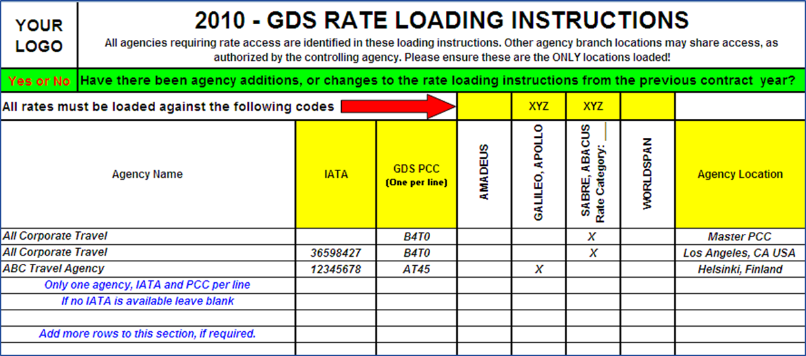
Rate Loading Instructions
Clear Messaging – Highlight Changes

Slide 10
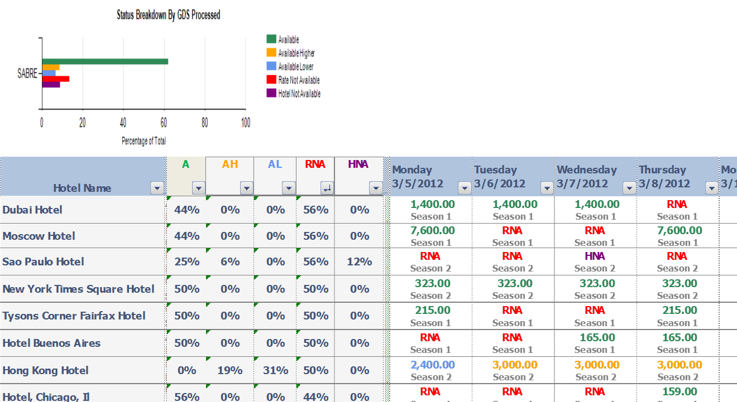
Rate Availability
Recent independent research indicates that up to 53% of negotiated rates that passed a rate audit were not available to be booked thru the corporate travel agency or self booking tools.

Slide 11
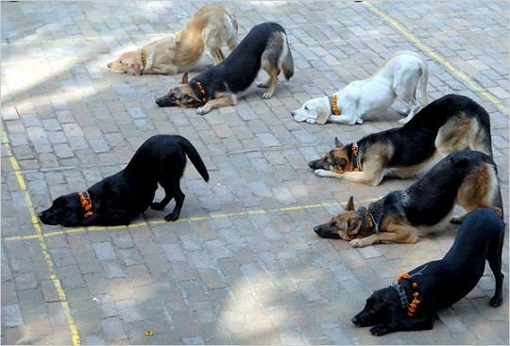
Managing Compliance
Travelers that book outside of set policies can drive up travel expenditures, undermine the rate negotiation process and create issues with safety and security.

Slide 12
Compliance - Communication
Online Directories
Online Booking Tools
Mobile Apps
Social Media
Invite Feedback
Integrate Expense Reporting
Flag out of policy at time of booking
Communicate changes/promotions regularly

Slide 13


