Slide 1
CWBTA - September 13, 2022
How To Feel Inspired, Connected & Confident
In The Chaos We’re Living In

Slide 2






Thank you to our Sponsors 2020
Thank you and big shout out to our CWBTA Board

Slide 3


CWBTA
Please make sure that you visit GBTA to review Chapter events -
You can join as member and some offer complimentary
Do you hold a Chapter member/GBTA access?
Consider Joining www.cwbta.org, as a member, volunteering on committee.
Watch the unveiling of the new GBTA brand
during Convention 2022.

Slide 4

GBTA
Professional Development
Now is the time to plan your education for 2022. Scholarships are available to GBTA and to Chapter members.
Click here to access course descriptions and to apply for one of these scholarships.
GBTA Ladders
Global Professional Leadership
Review other Chapter Events to join
August 14 – August 17, San Diego

Slide 5
How To Feel Inspired, Connected & Confident In The Chaos We’re Living In
Speaker:
Megan Miller, Intentional Living Expert
Founder
Megan-Miller.com
In today's hustle culture, where being on the go is an expectation and self care is on the back burner, too many successful professionals feel exhausted & direction-less and are craving more.
This interactive session offers listeners an environment where they let their masks down & have a refreshing conversation around the addiction to the drug of achievement.
Megan takes listeners through her 15 year corporate career leading sales for a $1B hospitality organization & the dark lonely world that she had created for herself. Listeners will then go through the intentional microsteps that she took to feel revitalized and connected to the woman she ignored, herself.
Together, we will build a foundation that collectively will feel as a community more confident, inspired, and connected to the person we’re never taught to know: ourselves.

Slide 6
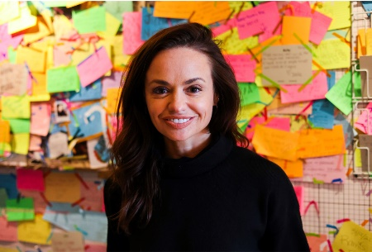
Megan Miller, Intentional Living Expert
Founder
Megan-Miller.com
Megan Miller is a professional speaker, creator and host of Attention to Intention podcast, and self-proclaimed Intentional Living Expert.
Over the past 15 years, her laser focus on climbing up the corporate ladder resulted in a successful career as a Sales Executive in the Hospitality industry, managing a portfolio of 150 domestically based hotels producing $1B in managed revenues.
Raised by a single mother in rural Pennsylvania, inflicted with a speech impediment and feeling like she had to fight for her seat at the table, Megan clawed her way to the corner office and landed her dream job. Despite being recognized for her accomplishments, Megan felt empty and unfulfilled. She found herself disconnected from life, $20k in debt, in a loveless relationship, and binge drinking to numb the pain. Her wakeup call came when she was gifted a Tony Robbins box cd set and soaked up the words like it was water on a hot summer day. After realizing that she was living in a lonely, dark world focused on hustle and achievement, Megan made a choice to be brave and get still, and start using power of using intention to live a more inspired life.
Megan is dedicated to offering high performing go-getting professional women simple, daily micro-steps for putting attention to intention so they can stop sleepwalking through life and start living with inspiration and fulfillment.
When not delivering her message of intentional living, Megan can be found with her husband Michael in their New Jersey home that they share with their 13-year-old beagle rescue, actively sweating it out with her Peloton community.
Go to Megan-Miller.com to join her community on Instagram and listen to her weekly podcast on all major streaming platforms, Attention to Intention

Slide 7

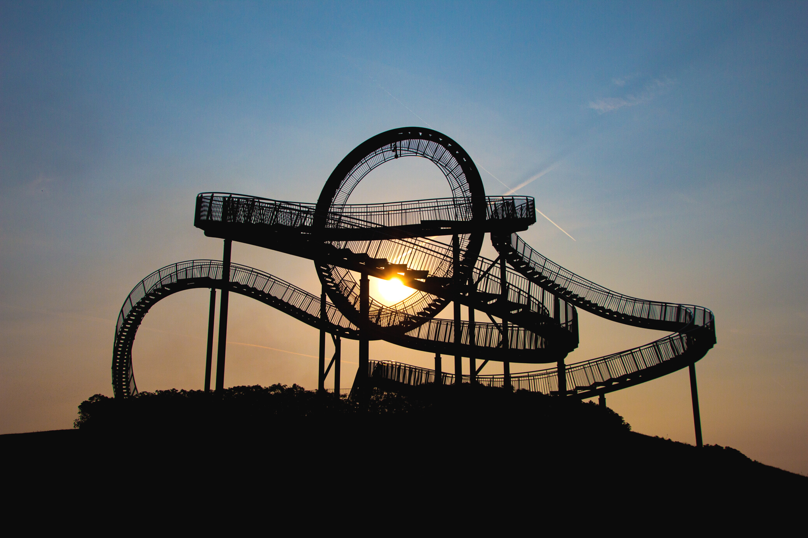

HOW TO FEEL INSPIRED, CONNECTED & CONFIDENT IN THE CHAOS WE’RE LIVING IN

Slide 8

76%
51%
11 YEARS

Slide 9
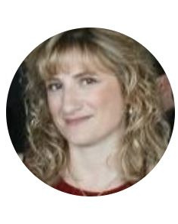
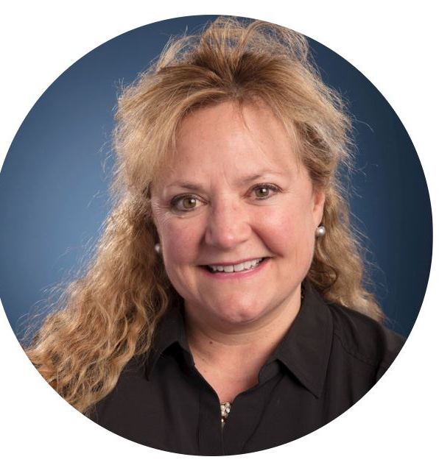
HERE'S TO THE POWER OF PURPOSEFUL COMMUNITY

Slide 10
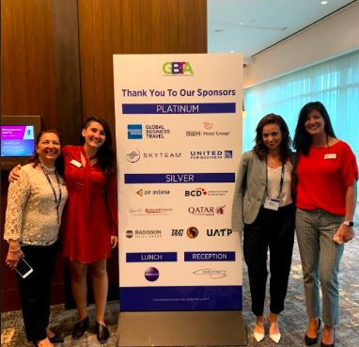
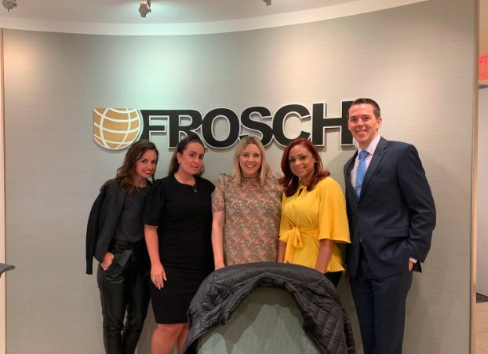
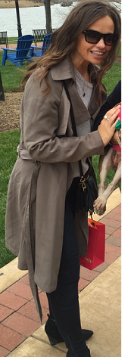
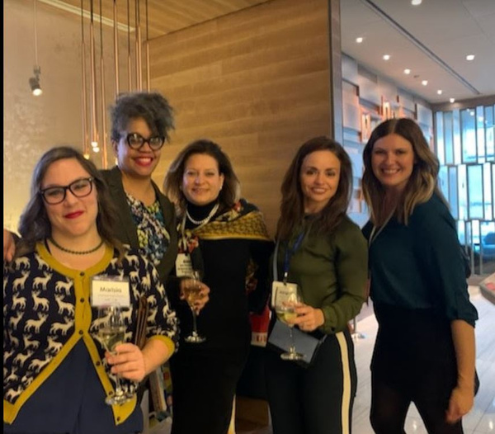
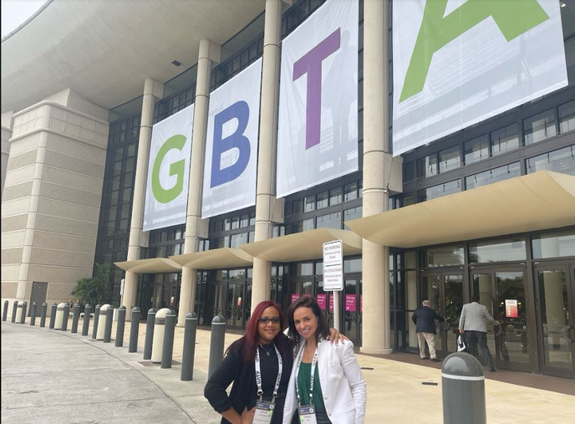

Slide 11
3 KEYS THAT WILL HELP YOU SHOW UP, SPEAK UP, AND FEEL INSPIRED & FULFILLED IN YOUR LIFE

Slide 12

WHO IS DRIVING THE CAR OF YOUR LIFE?
WHERE ARE THEY GOING?
WHAT DO THEY WANT?

Slide 13
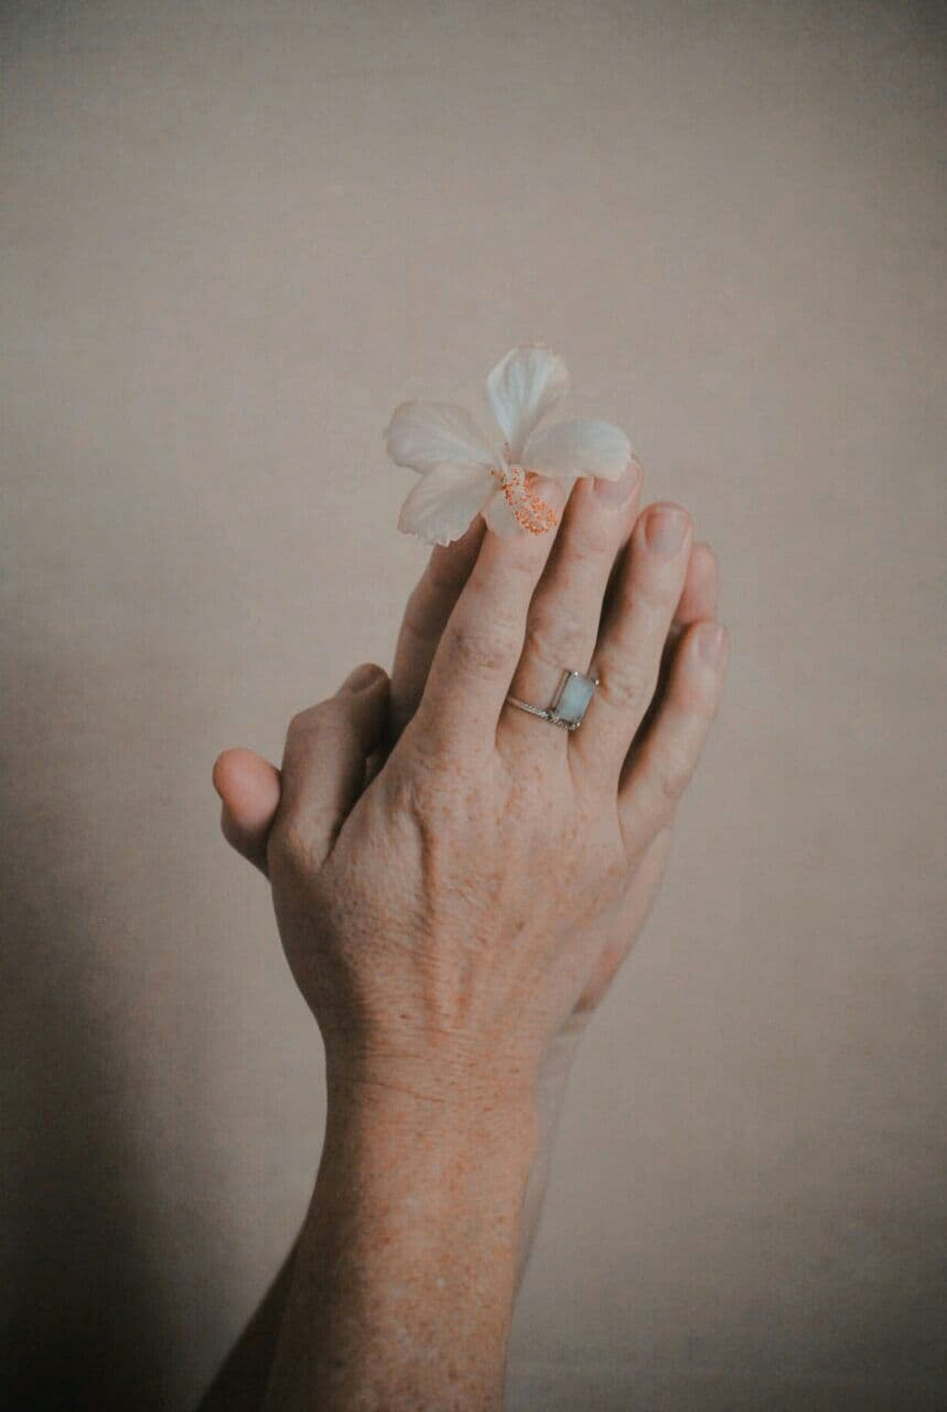
IF YOU DON'T SHOW UP FOR YOURSELF, WHY WOULD ANYONE ELSE?

Slide 14
DRAWERS OF YOUR LIFE
  01
  1
  2
  03
  04
  05
HEALTH & WELLNESS
WORK / CAREER
RELATIONSHIPS & LOVE
FUN & HAPPINESS
SELF WORTH
  6
1.HOW FULL IS MY TANK IN THIS AREA OF MY LIFE?
(FULL / HALF TANK / EMPTY)
2. WHAT DO YOU WANT YOUR LIFE TO LOOK LIKE IN THIS AREA OF YOUR LIFE
3. HOW DO YOU WANT TO FEEL
SPIRITUALITY

Slide 15

THE POWER IS NOT THROUGH INVESTING MONEY OR TALENT, IT'S THE SMALL DAILY HABITS

Slide 16
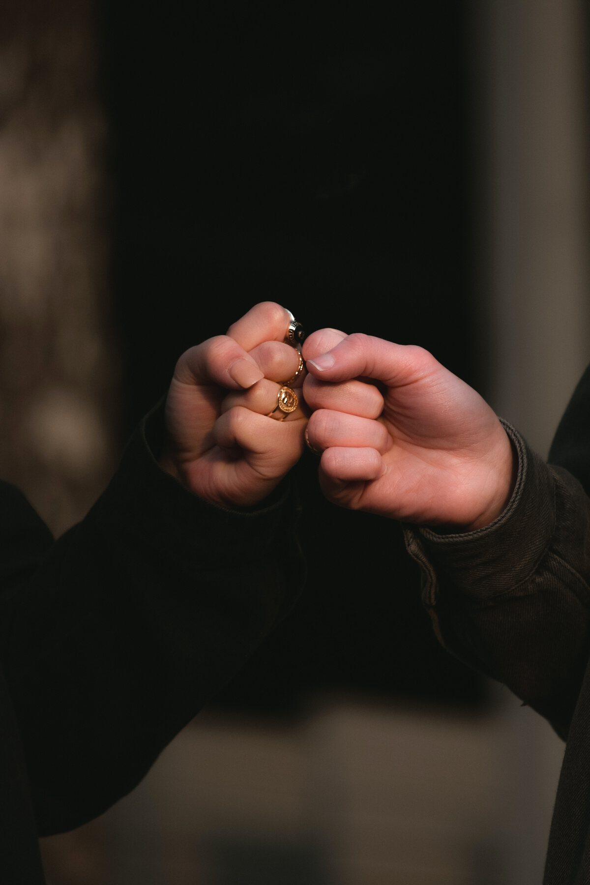
MAKE 1 COMMITMENT OF 1 MICROSTEP YOU'RE DOING TO IN THE NEXT 24 HOURS.

Slide 17
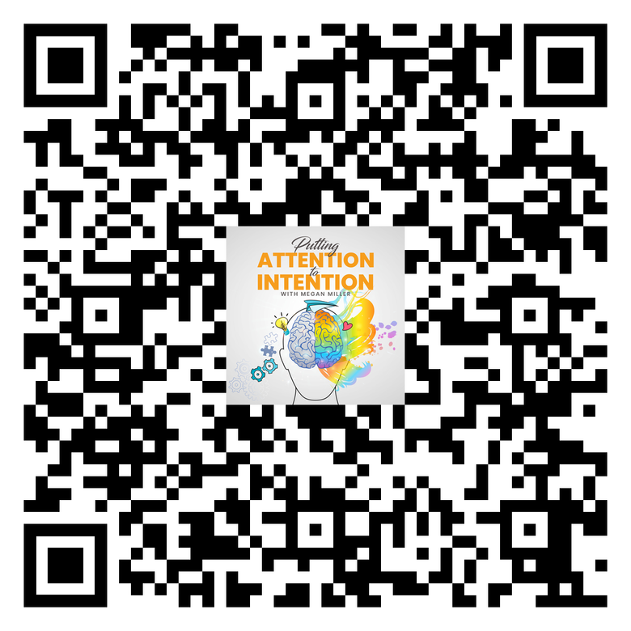
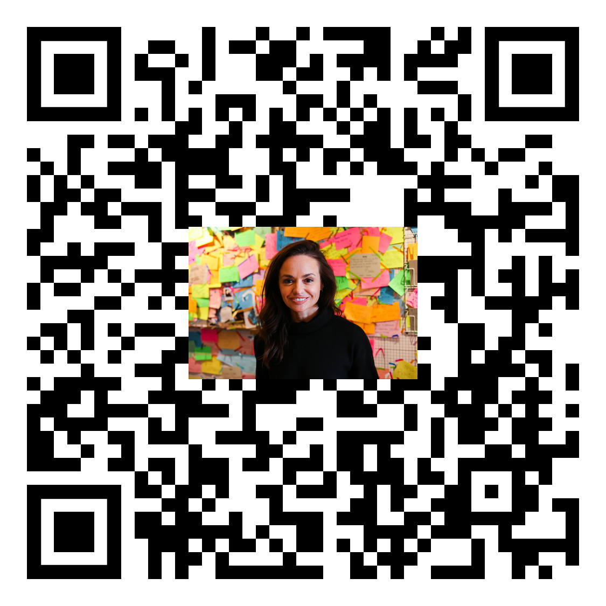
WHAT YOU LISTEN TO MATTERS:
SUBSCRIBE TO ATTENTION TO INTENTION PODCAST
MICROSTEP JOURNAL DOWNLOAD
MicrostepJournal.com

Slide 18

Help Us Deliver Content That You Want
Complete this 4 question survey

