Slide 1

How to Run a Successful Car Rental RFP
Bob Friedman
Director of Business Rental
Enterprise Holdings

Slide 2
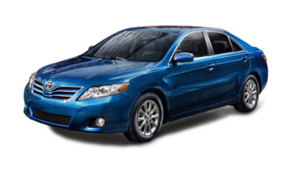
Car Rental RFPs
Hot Topics in the Car Rental Industry
RFP Trends
RFP Preparation, Tools and Formats
A “Typical” Corporate Account
Setting a Savings Benchmark
Incorporating Total Cost of Ownership
Making Comparisons & Getting the Best Price
The Pain of Change
Total Transportation Solution

Slide 3

Car Rental Industry Update
Burdensome Taxes & Fees
Consolidation
New Technology
Financial Strength
Globalization
Consolidation of TMCs

Slide 4
RFP Car Rental Trends
Long Term Agreements
Procurement Involvement
Limiting Number of Suppliers
Tracking & Managing Total Cost
Mandating use of Preferred Car Company
Attempts to Globalize
Increased focus on Customer Service
Shorter and Shorter Response Times

Slide 5
RFP Tools & Formats
Common Standard Formats
  GBTA Format
  TMC Branded Formats
Online
Challenges with Excel Documents
Incorporating Standard Terms and Exceptions

Slide 6
RFP Preparation
Research the Car Rental Market
Talk to your Counterparts
TMC Feedback
Request Actual Rental Data from Existing Supplier(s) and Set a Savings Benchmark
Get Customer “Status” List
Feedback from Top Travelers
Consider Total Cost vs. Price Questions
Be Prepared to Change

Slide 7
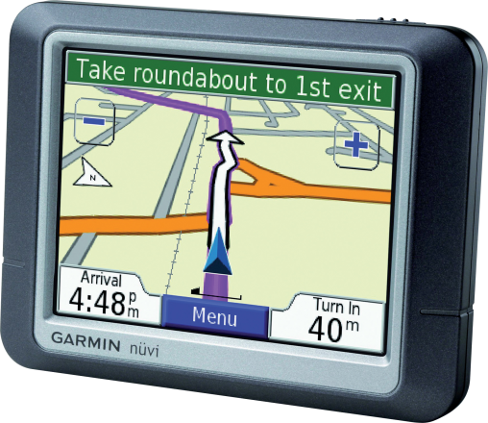
Car Rental Total Cost of Ownership
How does a $45 rate turn into a $60 rental bill?
Rental receipts include:
  Time & Mileage Charges (T&M)
    The Rates You Negotiate
  Taxes and Pass Through Fees
    Money that is collected and given to other entities
  Charges for Optional Services & Devices
  Business Practice Factors
What % of your Total Cost is affected by your Daily Rate?

Slide 8
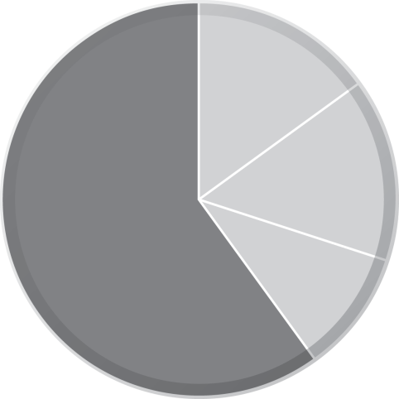
Proposal Background: Total Cost Solution
40%
Taxes & Fees:
  Lower cost,
  lower taxes
of what determines your total cost will be overlooked if daily rental price is the only focus.
15%
60%
Business Practices:
  Capacity Control
  Participating locations
  Energy Recovery Fees
  Blackout Dates
  One-way availability
  Best Rate
Time & Mileage:
  Base Rates
  Special City Rates
  City Differentials
  Mileage Fees
  One-way Fees
  Weekly Factor
  Monthly Factor
  One-day Surcharge
  Loss Damage Waiver
  Liability
15%
10%
Optional Services:
  GPS
  Refuel
  Toll Tag
  Satellite Radio
Notes:
Please create new pie chart in same theme as other charts in BRP deck
Time & Mileage: Base Rates, Special City Rates, City Differentials, Mileage Fees, One-Way Fees, Weekly Factor, Monthly Factor, One-Day Surcharge, Loss Damage Waiver, and Liability
Optional Services: GPS, Refuel, Toll Tag, Satellite Radio
Business Practices:
Capacity Control, Participating Locations, Energy Recovery Fees, Blackout Dates
Are Rebates On All Rentals?
One-Way Availability, and Best Rate
Taxes & Fees: Are They The Same?
Lower Cost, Lower Taxes
Bus Fees Can Vary
8

Slide 9
Above/Below the Line
Above the Line
    T&M – Availability of the Rates You Negotiate
Below the Line
    Other Charges – What is Negotiable?

Slide 10

Setting a Savings Benchmark
T&M Revenue / Days = Average Daily Rate

Slide 11
Business Practices Impact TCO
Above the Line: Corporate Rate
  Mid-size Availability
  Participating Locations
  Corporate Black Out Dates
  Impact of Best Rate

Slide 12
Business Practices Impact TCO
Below the Line
  Taxes & Pass Through Fees
  Optional Charges (Fuel, GPS)
  Revenue Generating Fees

Slide 13
A “Typical” Corporate Account
Length of Rental 3 Days
Miles per Day 65 Miles
Percent One-way 5%
Percent w/ GPS 10%
Percent w/ RSC 20%
Percent paid by Credit Card 95%
Percent booked w/ GDS 80%
Percent Web Reservation 10%
Percent Rentals in Top 10 Cities 50%
Frequent Flier Opt in 70%
Account designates a Primary and Secondary vendor
Account has Travel Policy directing usage to Preferred Suppliers

Slide 14

Making the Comparison
Ask questions about non-mandatory charges and fees.
Put a dollar value to an unfavorable business practice
  Late Fees, Automatic Fuel Charges
Analyze the cost of fuel
A TCO analysis can result
in a $5-10 per day difference,
even when “rates” are the same!

Slide 15

Getting the Best Price
Once the rate comparison is done, review other cost components based on your good RFP Questions:
  Identify any fees that can be negotiated
  Compare cost of Optional Products, especially Fuel
  Give an advantage to the company with standard business practices that reduce total cost
    Black out dates, Participation, Best Rate, Mid-size Compliance

Slide 16
Evaluating Customer Service
Customer Service Awards
# of Locations with Express Service
Comparison of Loyalty Program Benefits
Financial Stability
Quality and Size of Fleet
Franchise Participation and Structure
Locations Coverage
Quality of Account Manager

Slide 17
Change and Implementation
Are there any service gaps?
What is the cost of change?
Will anyone need to “sacrifice”?
Understand the Implementation Steps
  Will the plan work with your culture and communication requirements?
How will your TMC assist?
Is the Timeline realistic and doable?

Slide 18

Total Transportation Solution
Think broader than daily car rental
  What is your Mileage Reimbursement budget?
  Do you rent specialty cars and commercial trucks?
  Do you lease vehicles?
  Will car sharing help you meet your goals?
  Is there an opportunity for van-pooling?

Slide 19

Roundtable Topics
Do you enforce use of your program? (Suggested or mandated)
If mandated, how do you identify leakage?
What types of exceptions do you allow?
How do you measure the success of your program?
What is one thing you would ask your vendor to change about the service? Wish list?
What has worked (or not worked) because the program and/or policy is in place?

