Slide 1
A New Standard of Travel
November 2020 Amtrak Updates for CWBTA
Presenter: Steve Joyce, Principal Manager, Corporate Sales
Date: November 17, 2020

Slide 2
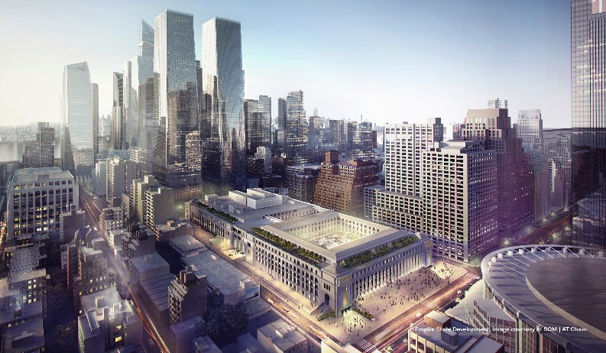
Moynihan Train Hall at NY Penn Station
8

Slide 3
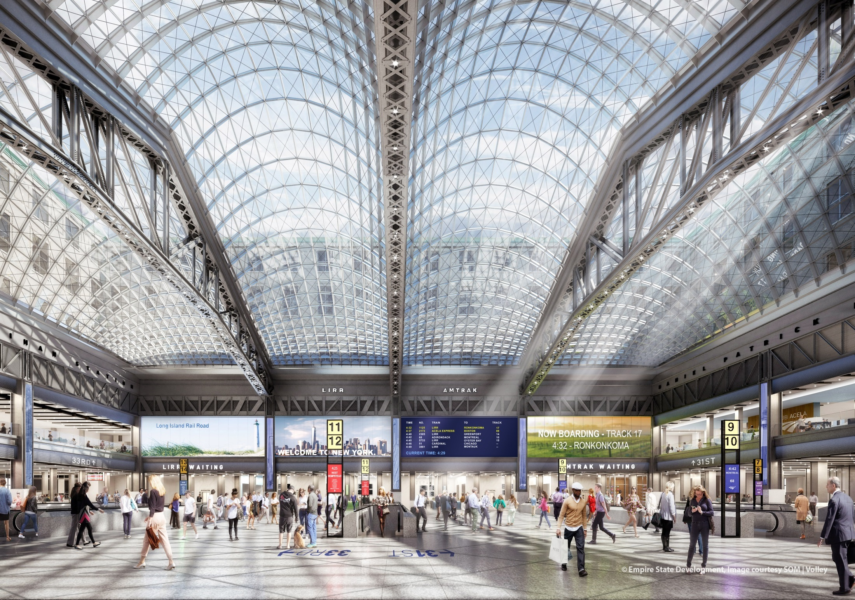

Slide 4
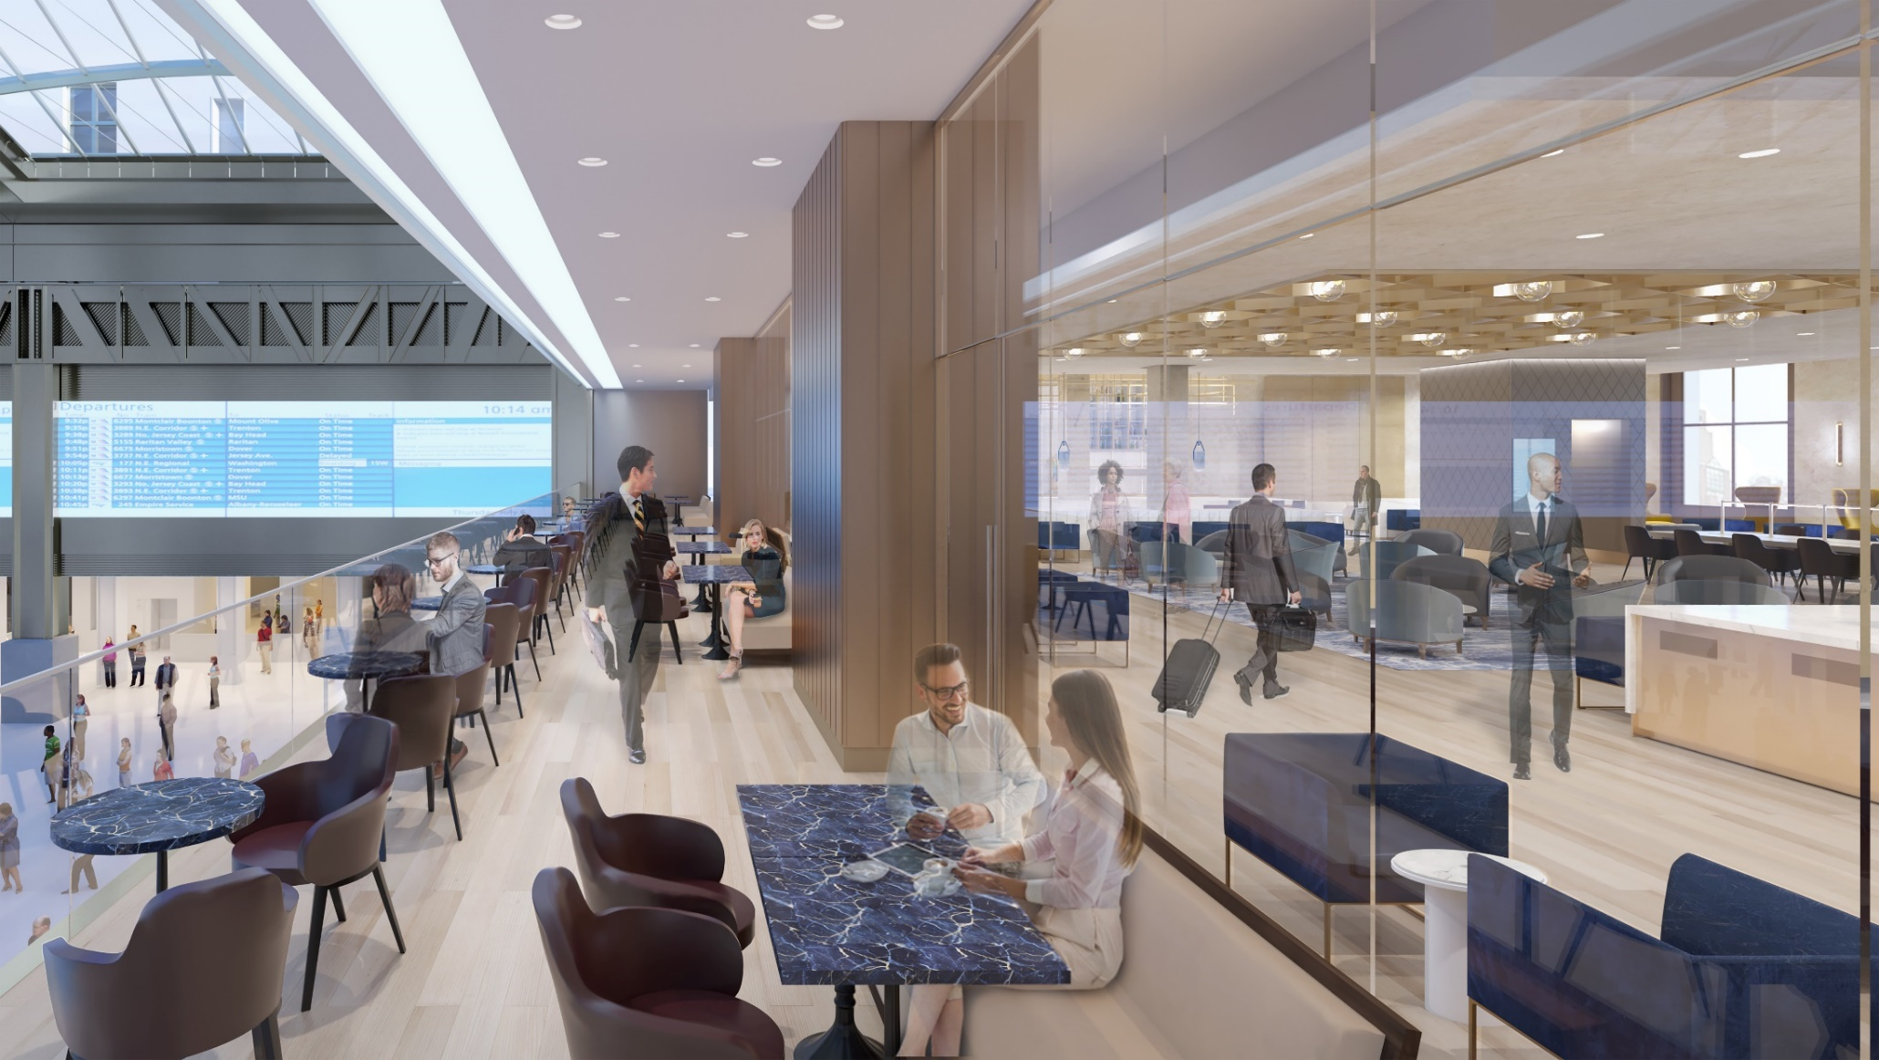
Metropolitan Lounge

Slide 5
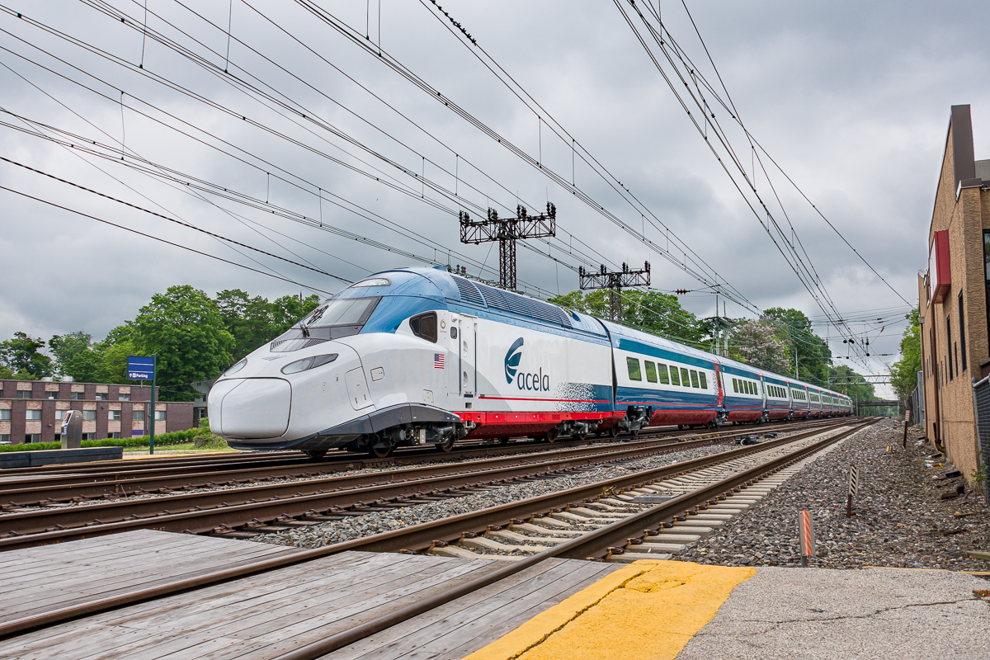
Arriving in 2021!
Notes:
https://youtu.be/RMMkVQ3PWqw

