Slide 1
CWBTA - November 17, 2020
What’s up with Ground Transportation

Slide 2
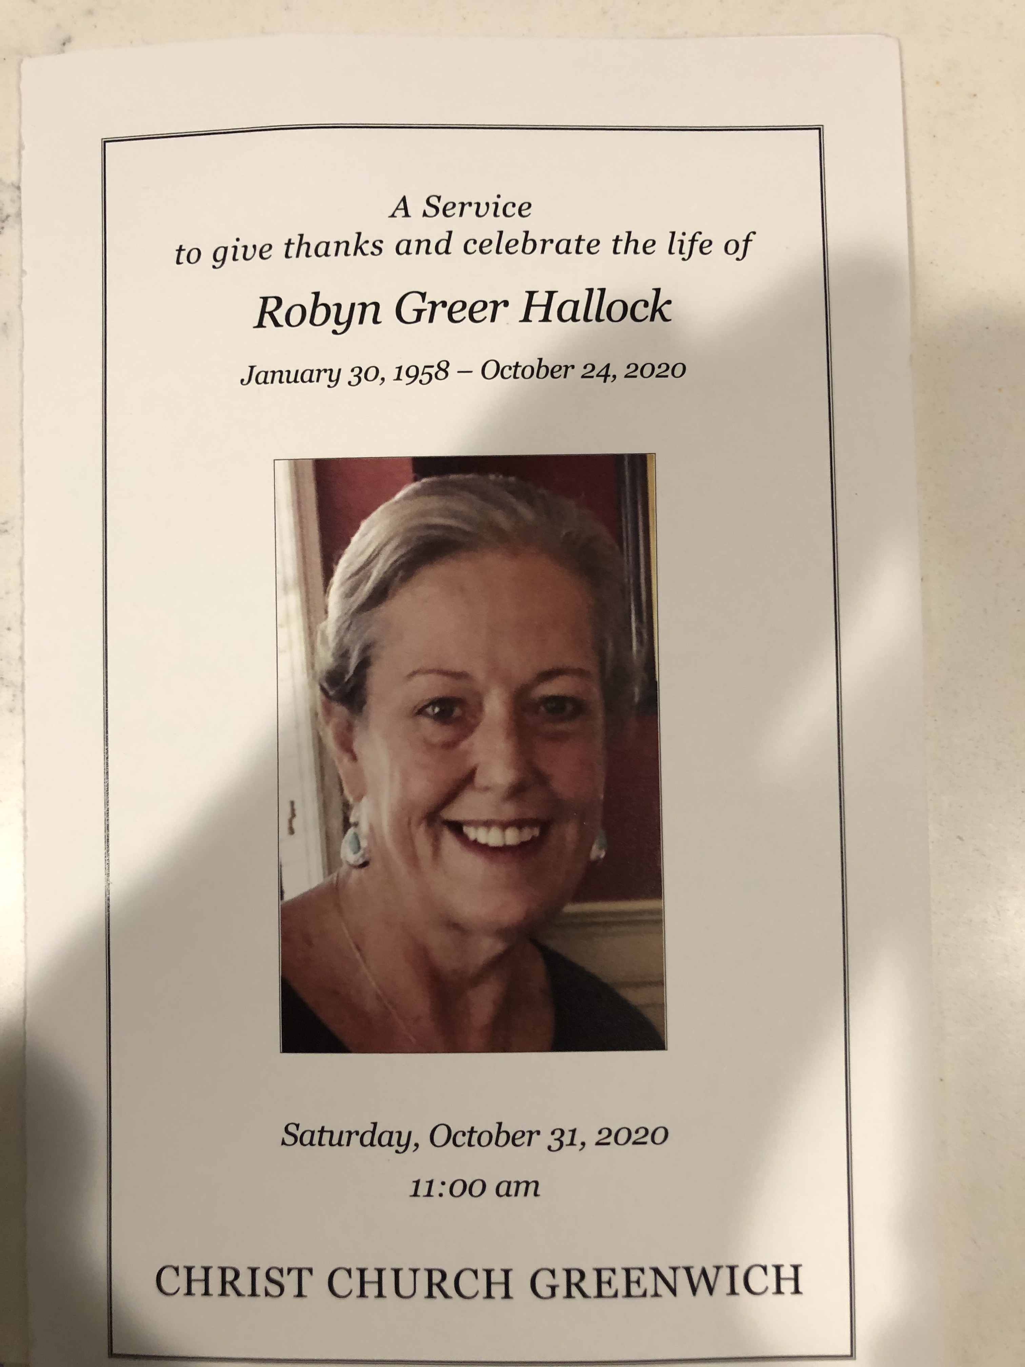
Robyn Greer Hallock
Remembering a very special CWBTA past President and friend

Slide 3


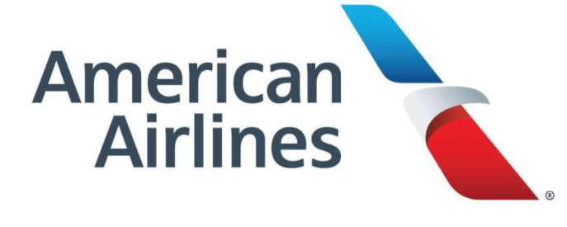



Thank you to our Sponsors 2020
Thank you and big shout out to our CWBTA Board

Slide 4
CWBTA
Please make sure that you visit GBTA to review Chapter events -
You can join as member and some offer complimentary
Do you hold a Chapter member/GBTA access?
Consider Joining www.cwbta.org become a member
For those CWBTA members that have been furlough or laid off CWBTA is extending membership till June 30, 2021
Please review GBTA membership information
Next meeting Tuesday, December 15 - Holiday

Slide 5
CWBTA
If you would like to donate $20, you will be entered into a raffle to win:
(2) Round Trip tickets US48 on United Airlines OR
(2) Round Trip Acela tickets NYC to DC
The following people are will be entered in the raffle and name will be called at end of presentation.
Lisa
Susan
Jeanne
Lori
Julie
Aileen
Angela
Stephen
Marcia
Fred
Stephen

Slide 6
United Airlines
Amtrak

Slide 7
What’s up with Ground Transportation
Panel Discussions
  Trends and Overview
  Technology Enhancements
  Hear on Ground Transportations safety measures
  How has private car or shared economy been impacted?
  What challenges have been faced? Obstacles?
  What steps are being taken?
  Advantages/Disadvantages - Biggest pain point that 2020 has been faced?
  Have you worked with the AGTA (Airport Ground Transportation Association) more now?
  More communications to your customers?
  2021 Outlook

Slide 8
What’s Up with Ground Transportation
Speakers:
Trevor Franklin, President, and Chief Executive Officer, MTC Limousine & Corporate Coach, Inc.
Jeff Nyikos, President Leros Point to Point | Royal Coachman Worldwide
John Persche, Account Manager, Uber for Business, Lauren Schroeder, Account Executive
Sean Beatty, Senior Account Executive, Lyft Business
Moderator:
Elliott Arluck
Former Senior Client Executive at CWT

Slide 9
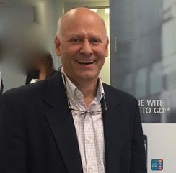
Moderator
Elliott Arluck
A long-term travel professional, primarily spent his career with travel management giant, CWT (Formerly known as Carlson Wagonlit Travel).
Half his tenure was managing agent groups both in call centers and onsite for a variety of client types. The other half was primarily in client management where his analytical skills, cheery management style and devotion to his clients led to a 100% retention rate. He was twice bestowed his Company’s Award of Excellence for his work.

Slide 10
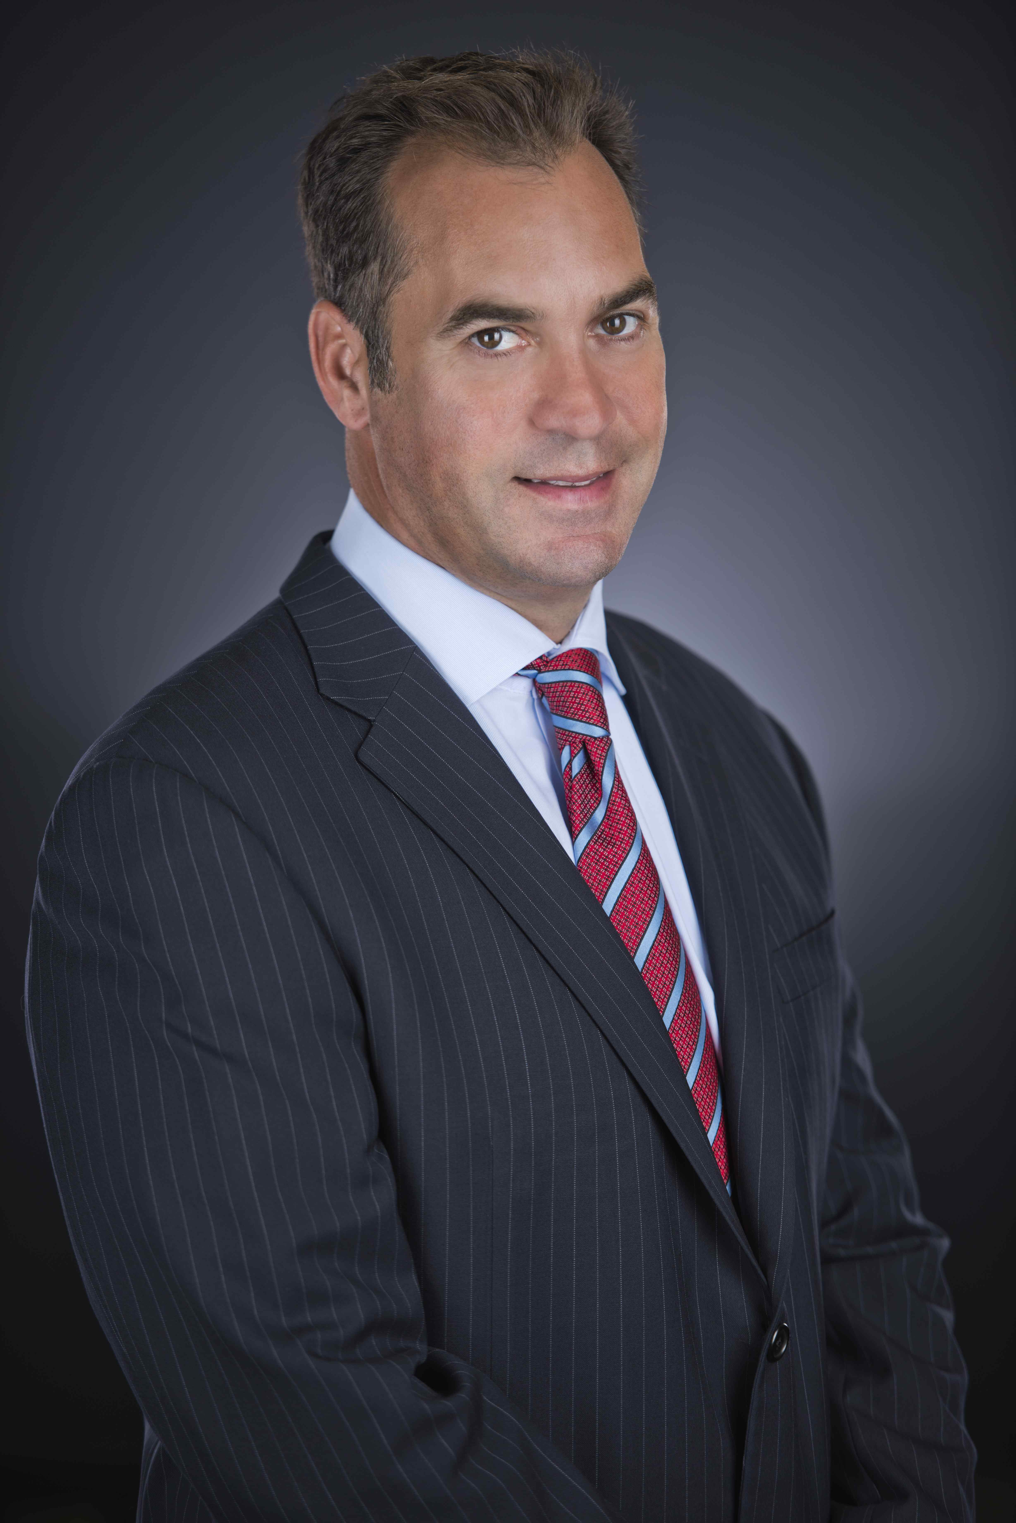
Leros Point to Point/Royal Coachman
Jeff is President of Leros Point to Point/Royal Coachman a renowned global ground transportation company with its headquarters in Valhalla, New York. Jeff has worked in many positions at Leros Point to Point over the past 27 years learning the business from the ground up just like his father John did. Over the past five years, Jeff has been instrumental in positioning Leros as a leading transportation company. Prior to the current pandemic, under Jeff’s leadership, Leros has more than doubled in size in the past 3 years.
Jeff has volunteered for a number of charities to include JDRF, Boys and Girls Club of Northern Westchester, IAHD, Hillside Outreach, and the American Cancer Society. He
is currently on the board of GBTA’s local chapters in Westchester & Fairfield County.

Slide 11

MTC Chauffeured Transportation Solutions
Trevor Franklin is the President & CEO of MTC Chauffeured Transportation Solutions. He has 35 years of experience in ground transportation, strategic sourcing, strategy, implementation, auditing, policy and practices. He has proven successes in leading his business, improving service delivery, designing innovative ground technology, developing disciplined operating metrics and financial measures and leading effective MTC teams.
Since the founding of MTC in 1985, Trevor Franklin has provided leadership and motivation to an organization of increasing size and complexity. With his partner, Jim Rubin, Trevor took a start-up with one car to a company to a multi-location operation with vehicles from sedans to busses.
Demanding the highest levels of quality and customer service, Trevor has set high standards for each of MTC’s staff. These standards have resulted in substantial growth and the maintenance of long-term client relationships with many of the largest corporate clients in the New York Metropolitan area market and the development of an extensive international network.
MTC has been a staple in the luxury corporate, roadshow, group and meeting transportation industries. MTC provides services in more than 500 cities worldwide

Slide 12
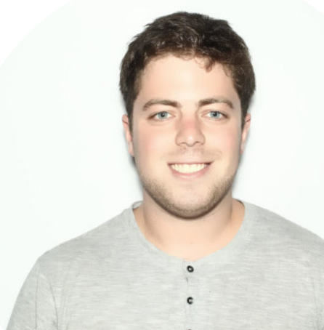

Uber for Business
John Persche is an Account Manager on Uber for Business. He works with organizations organizations that are currently leveraging Uber’s corporate tools to create further efficiencies and tailor usage of the tools to meet their needs. This includes tools for Employee & Guest Travel, Patient Travel, Transportation of Company Products, and Uber Eats Tools. He is usually located in New York City, but is currently working from home in San Diego.
Lauren Schroeder is an Account Executive on Uber for Business. She works with companies across a wide array of industries including tech, finance, law and hospitality, leveraging the Uber for Business solution suite to provide ride, meal and delivery solutions. Lauren is based out of New York City.

Slide 13
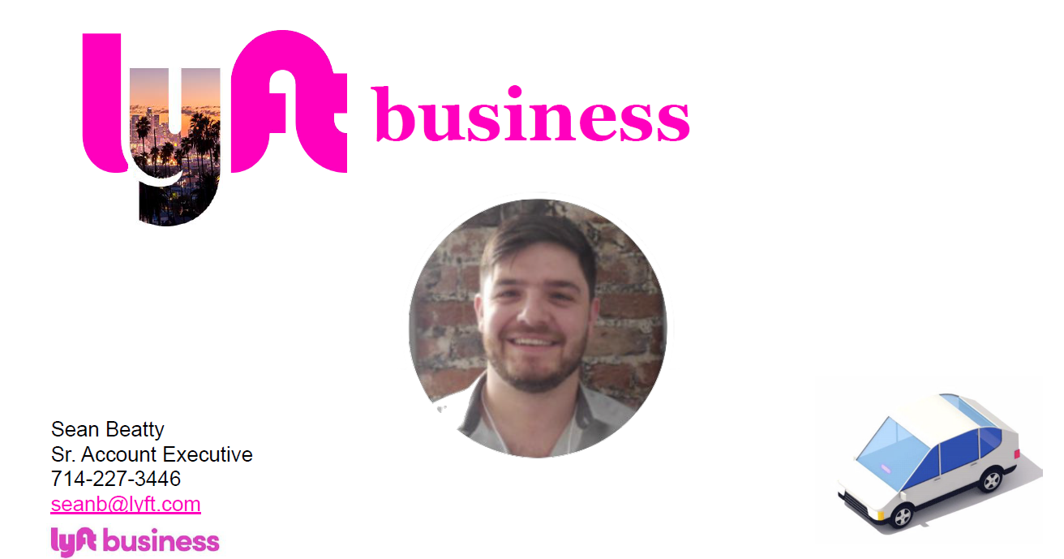
Lyft Business

