Slide 1
Connecting the world more safely
CWBTA Presentation: November 17, 2020
United Sales Manager: Aileen Moriarty

Slide 2
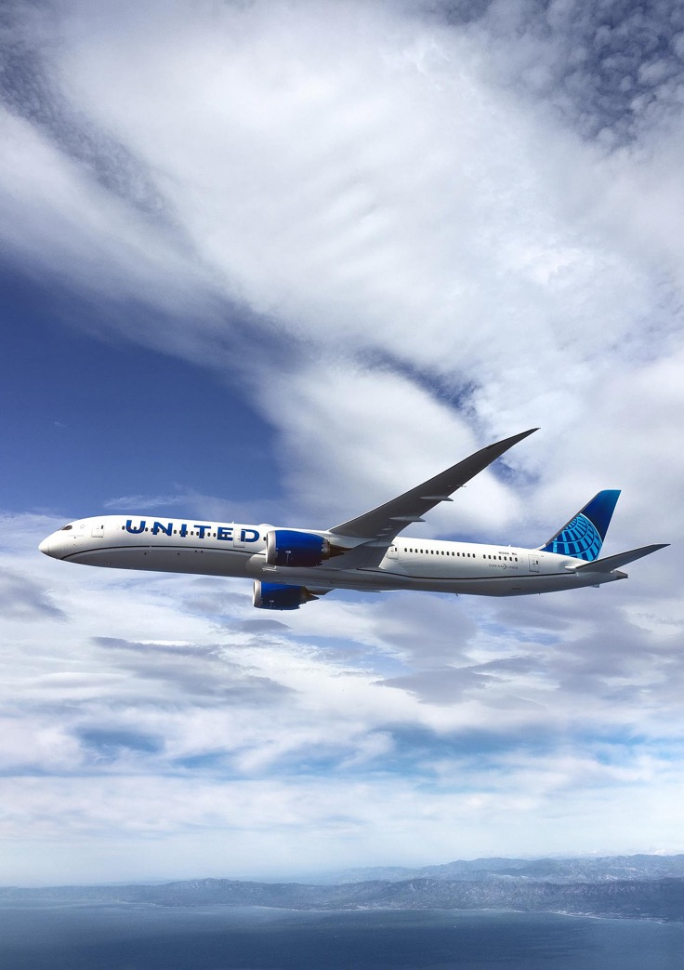
Your risk of exposure to COVID-19 is almost non-existent on our flights
In the most comprehensive study on aircraft airflow that’s ever been done the U.S. Department of Defense determined the risk is virtually non-existent.
THE STUDY FOUND:
When a passenger is seated and wearing a mask, on average only 0.003% of infected air particles could enter their breathing zone, even when every seat on the plane is occupied.
Fast onboard air recirculation, downward designed air ventilation and efficient HEPA filters make the cabin of a United airplane one of the safest indoor environments in the world.

Slide 3
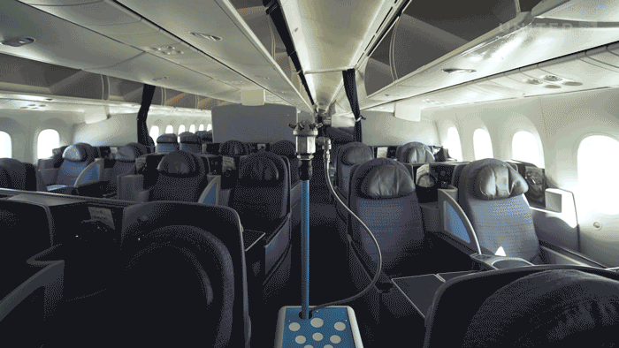
Layering our approach to safety by adding antimicrobial coating onboard
What does “antimicrobial coating” do?
This antimicrobial coating forms a long-lasting bond with surfaces to inhibit the growth of microbes.
Where will it be applied?
Adding to over 30 new aircraft each week, starting at Chicago O’Hare
Coating seats, tray tables, armrests, overhead bins, lavatories and crew stations

Slide 4
Forging a new flight path by Initiating Change
Our commitment to you and your travelers has never wavered
https://united.business/2020
NO MORE
CHANGE FEES
UNITED CLEANPLUS
GLOBAL NETWORK
We were the first U.S. global network airline to permanently eliminate change fees for travel within the U.S. on all standard economy and premium cabin tickets.
With the goal of delivering an industry-leading standard of cleanliness, we teamed up with Clorox and experts from the Cleveland Clinic, and also launched United CleanPlus℠.
We were the only U.S. carrier to maintain scheduled passenger service between the U.S. and both Israel and Australia, along with flights to Tokyo, Sao Paulo and London.
MILEAGEPLUS
REASSURANCE
KEEPING YOU INFORMED
MileagePlus Premier members will retain their earned status through January 2022, and we reduced thresholds for published status levels to make reaching a higher status easier.
Corporate contracts expiring in 2020 may be extended with existing negotiated discounts. Plus, 2020 contract performance will not affect contract renewals.
We’re committed to keeping you informed, and have delivered through relevant and timely weekly email updates and frequent United for Business Customer Forums.

Slide 5


Additional United options to support your business
CHARTERS
Dedicated fleet of Boeing 777 and 787 fleet to transfer freight to and from U.S. hubs and key international business locations
Operating a schedule of 40 cargo charters; continuing to seek additional opportunities
Customized flight experience, tailored to your needs
Private access to the aircraft; professional United staff
Flexible schedule for one time or weekly charters
Aircraft available for groups of all sizes (from 50 to 350 seats)
CONTACT YOUR ACCOUNT MANAGER FOR ADDITIONAL DETAILS

Slide 6


